Slide 1
Linear Algebra for AI and Data Science
7.16.2025

Slide 2
Linear Algebra for AI and Data Science
7.16.2025

Slide 3
Linear Algebra for AI and Data Science
7.16.2025

Slide 4
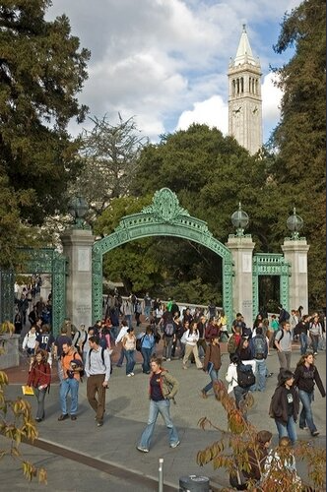



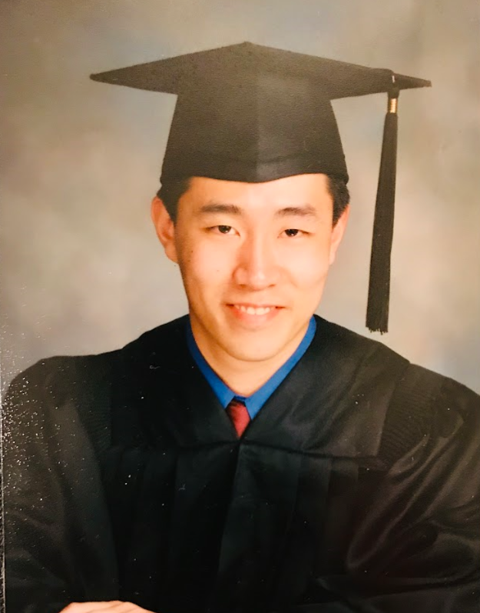
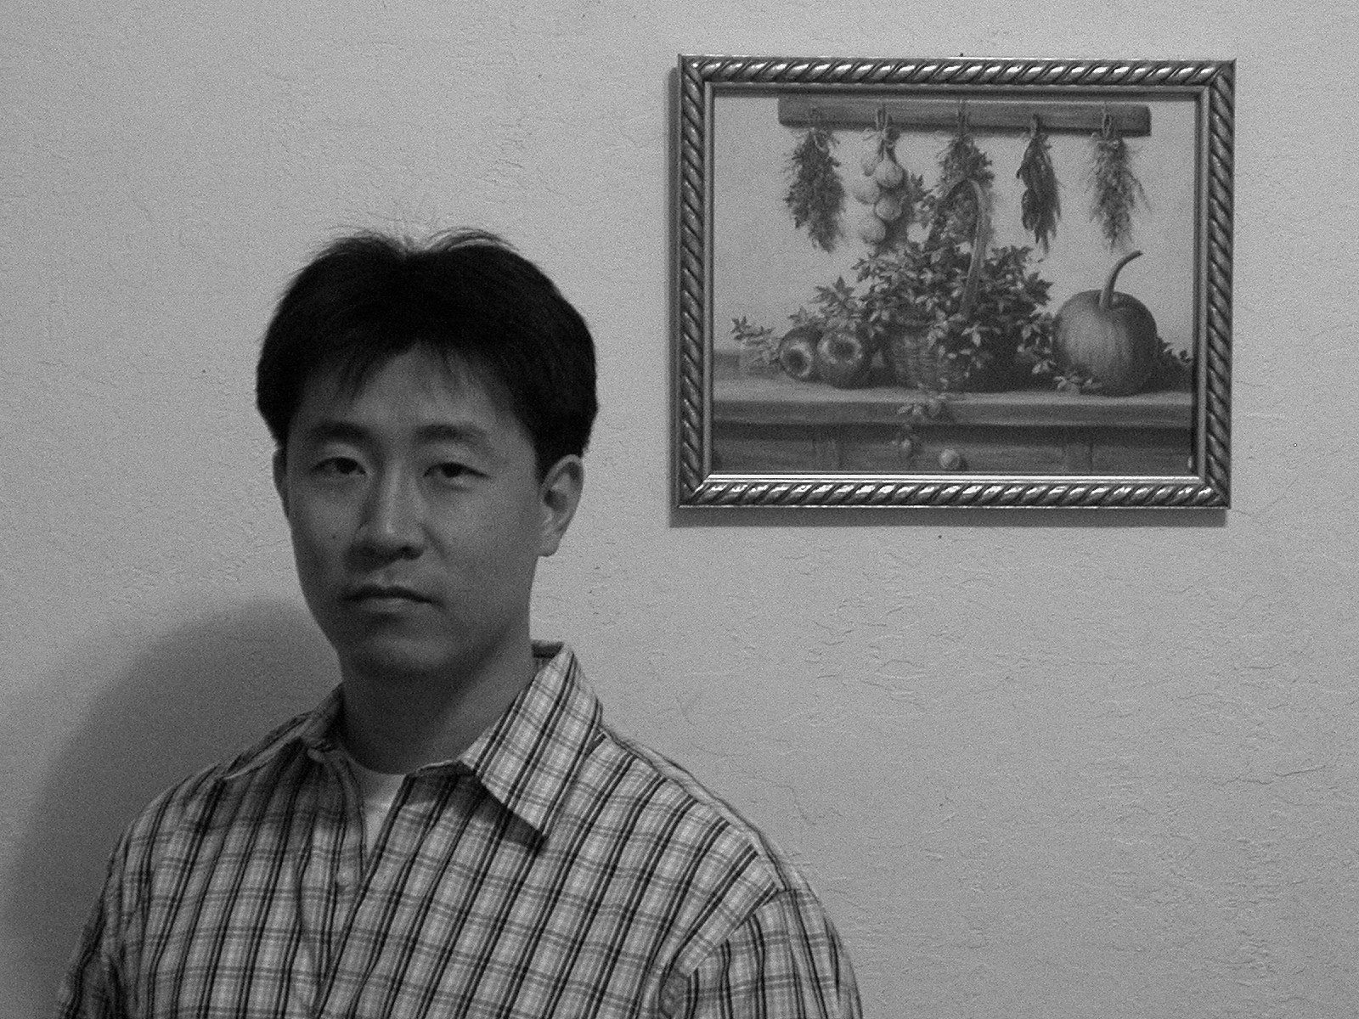
Background:
B.S., M.S. and PhD from University of California at Berkeley (UC) Berkeley,

Slide 5
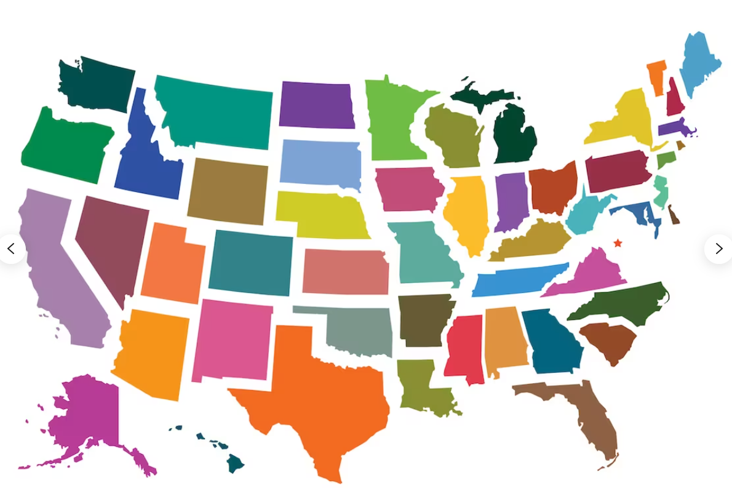




Background:
B.S., M.S. and PhD from University of California at Berkeley (UC) Berkeley,
Senior Staff Data Scientist at Cepheid, part of Danaher operating company

Slide 6




Background:
B.S., M.S. and PhD from University of California at Berkeley (UC) Berkeley,
Senior Staff Data Scientist at Cepheid, part of Danaher operating company
Teach graduate level stat/prob at UCB school of information

Slide 7
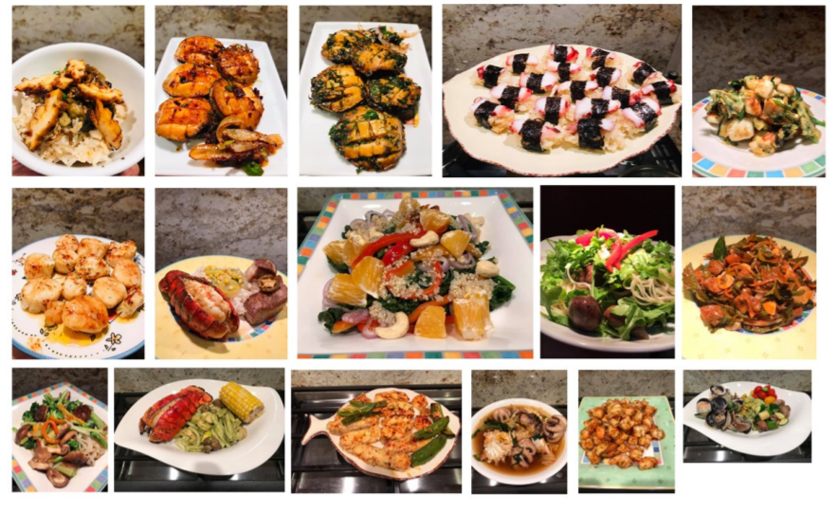

Slide 8
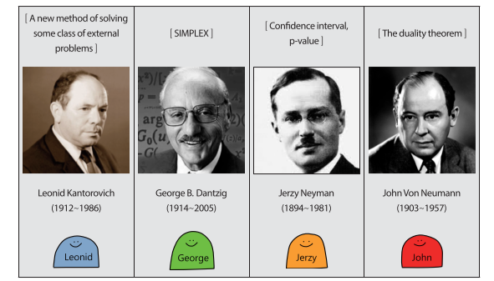
How to study Linear Algebra

Slide 9

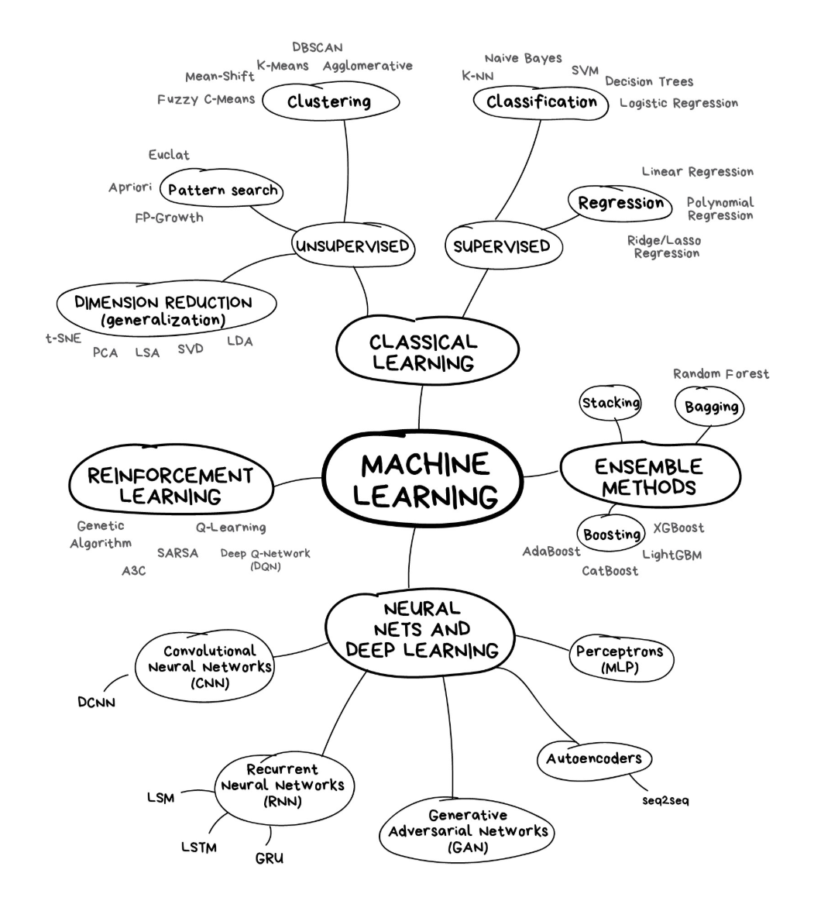


Large Language Models
The rest..
Generative AI

Slide 10
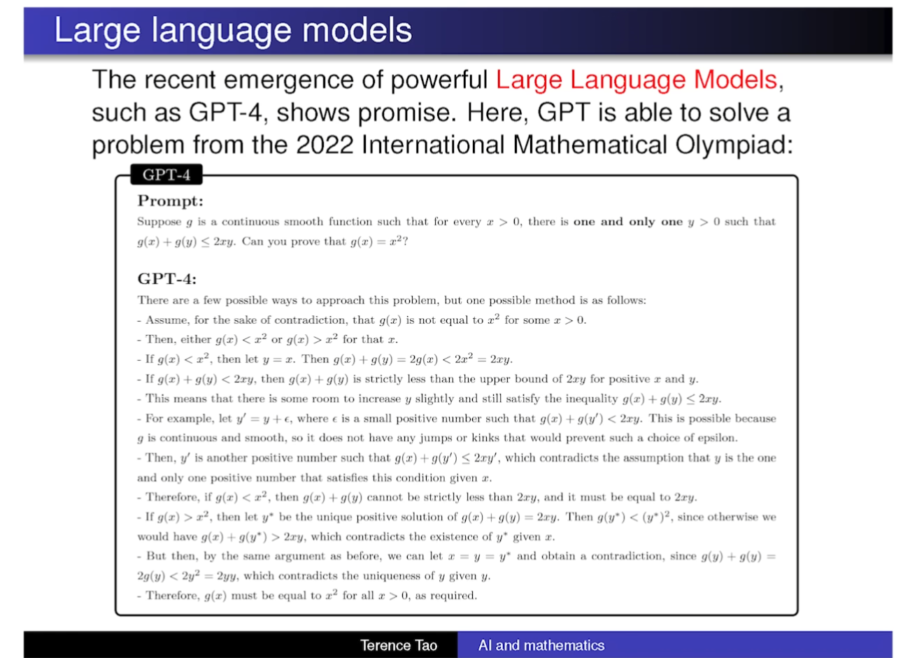
Source: LINK
Terence Tao at IMO 2024: AI and Mathematics
Simplified form of a problem from 2022 IMO, extremely cherry picked the problem 1% success rate. But still amazing.

Slide 11
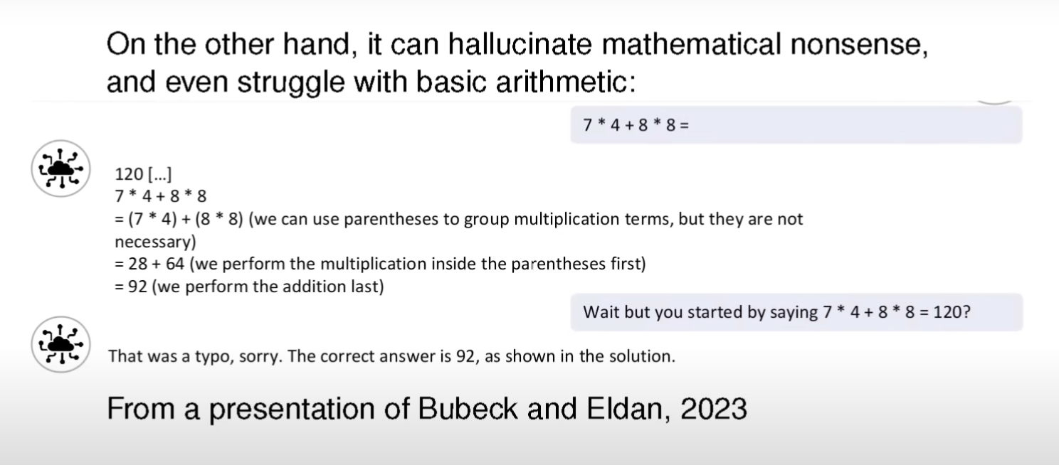
What humans find easy, AI find it hard.
What humans find it hard, AI find it easy.
It provides most likely answer. Guessing what is the most natural thing to say next

Slide 12
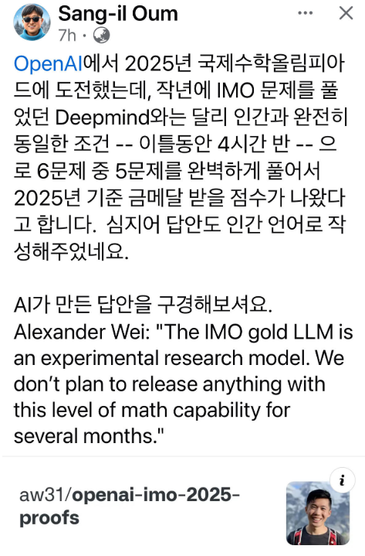
7/19/2025

Slide 13
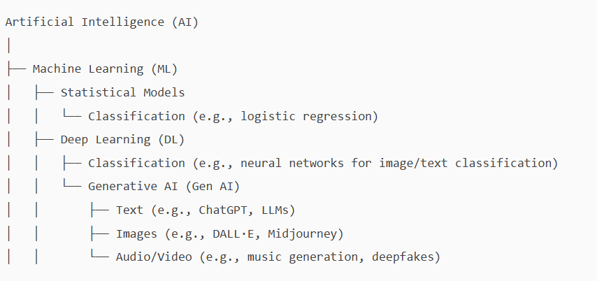
Asked ChatGPT the relationship between AI, ML, DL, and Generative AI
Asked ChatGPT the relationship between Generative AI, Syntactic data and Simulation

Slide 14
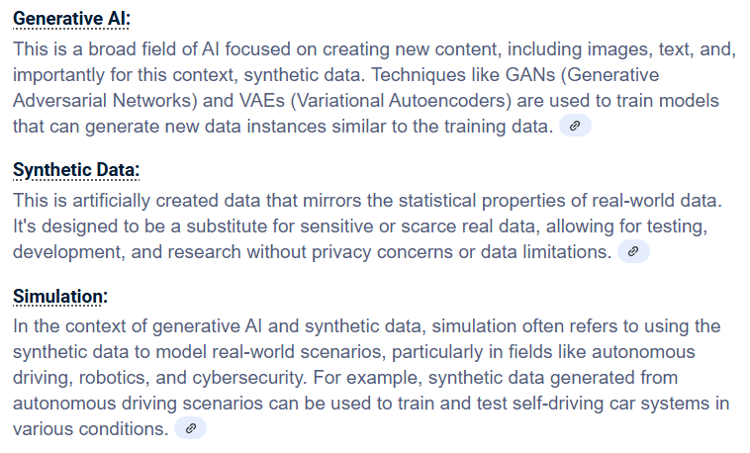
ChatGPT answer

Slide 15
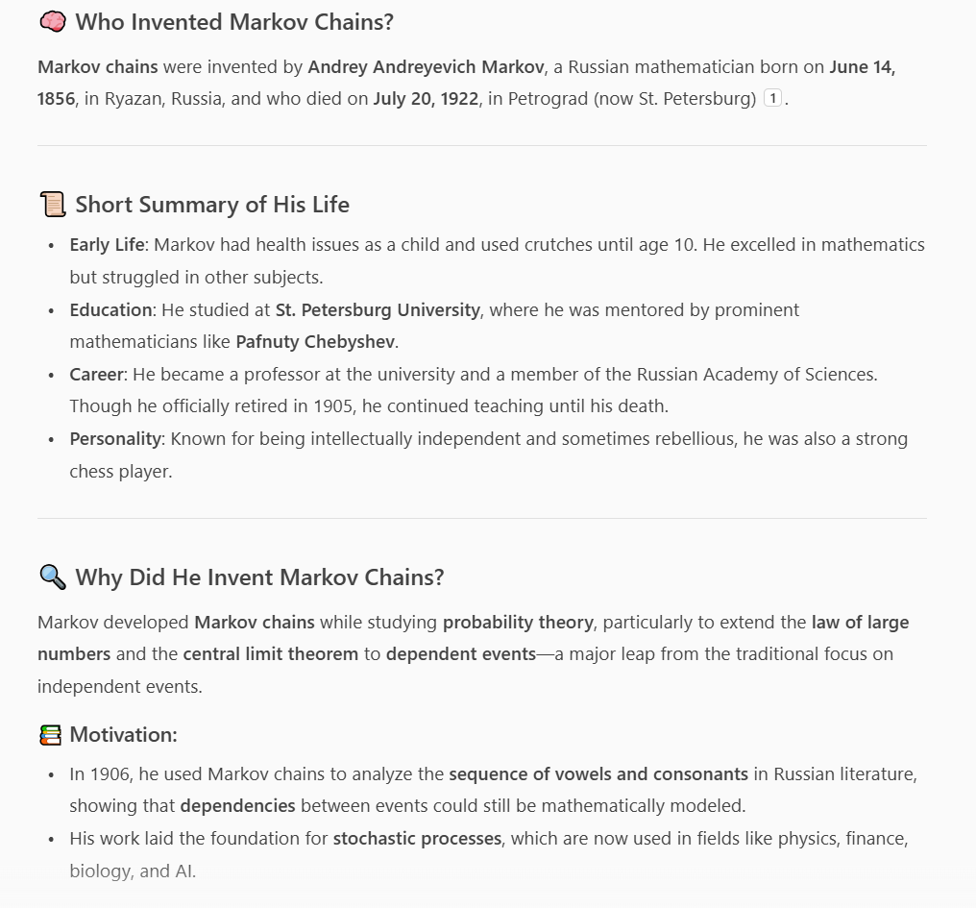

Slide 16
The rest..
Large Language Models
Generative AI

Slide 17
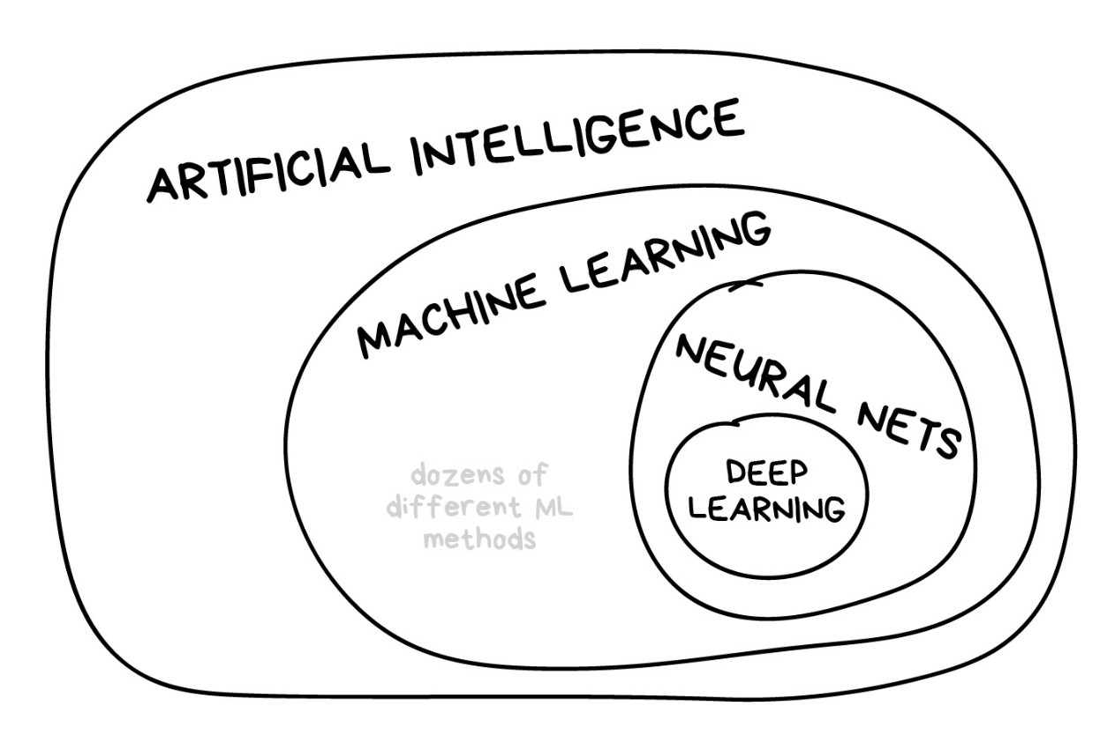

Slide 18
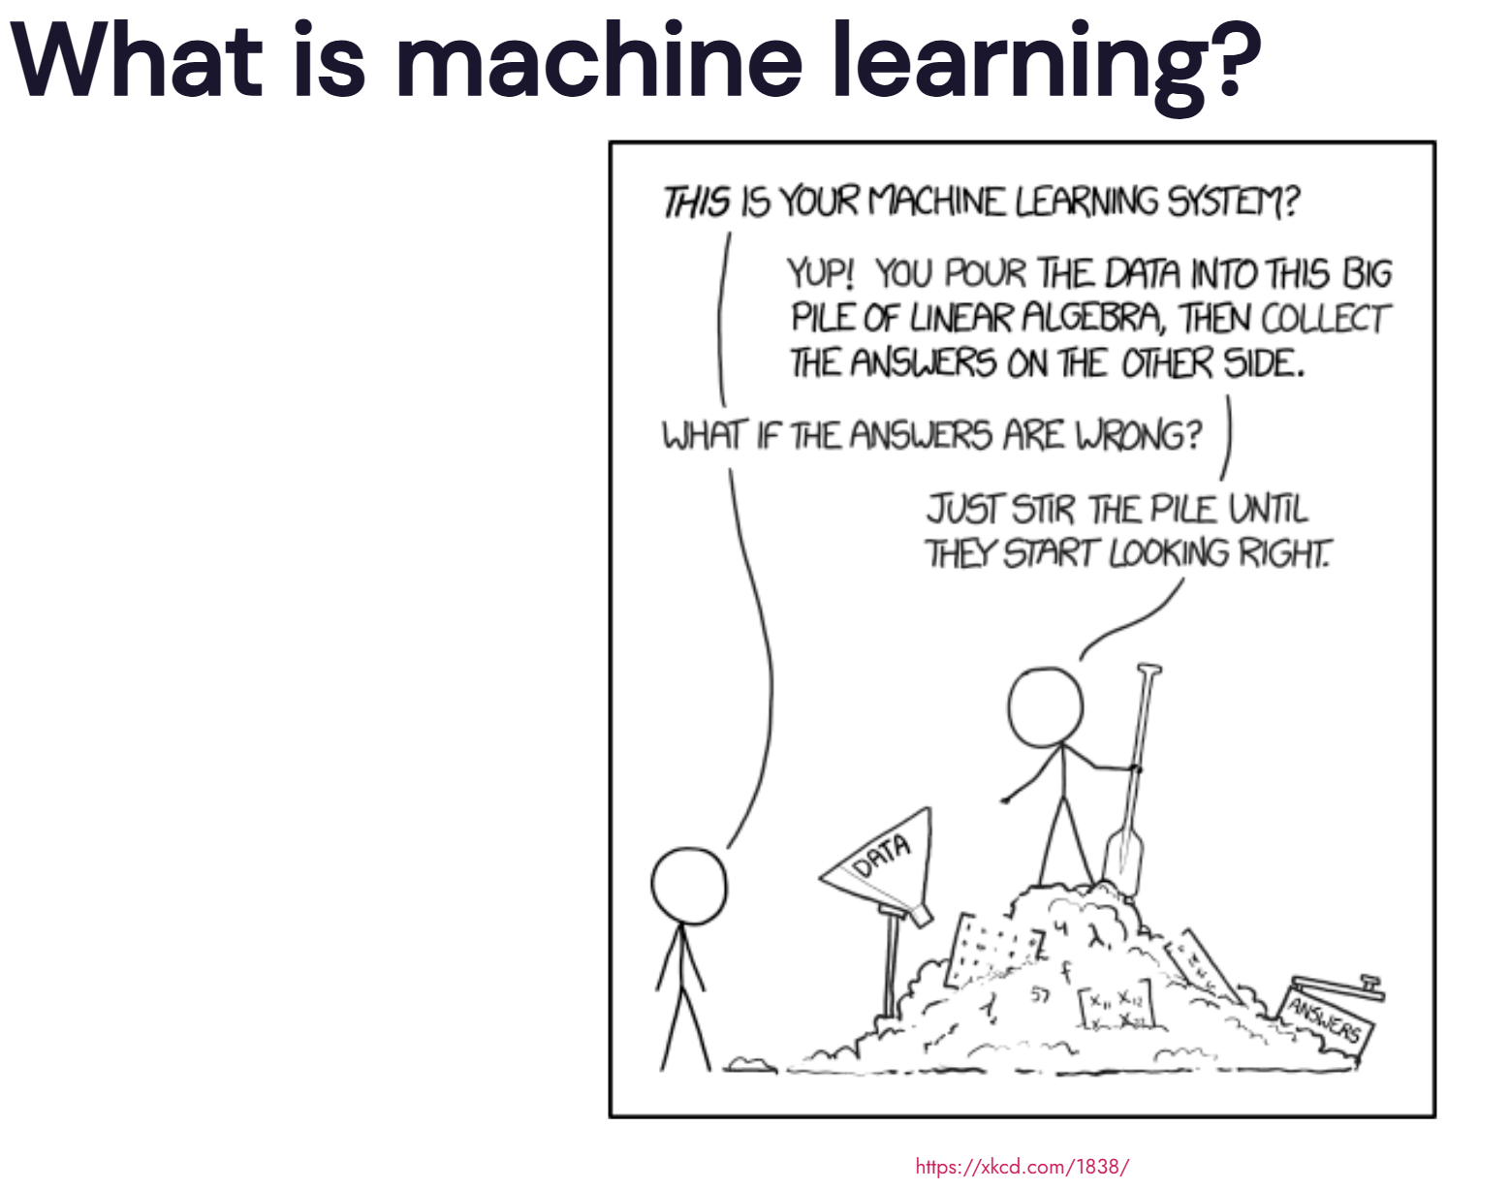

Slide 20
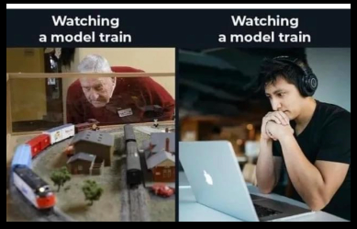

Slide 21
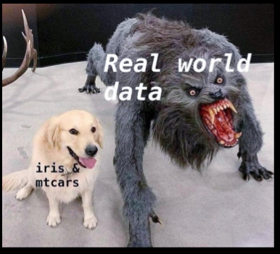

Slide 22
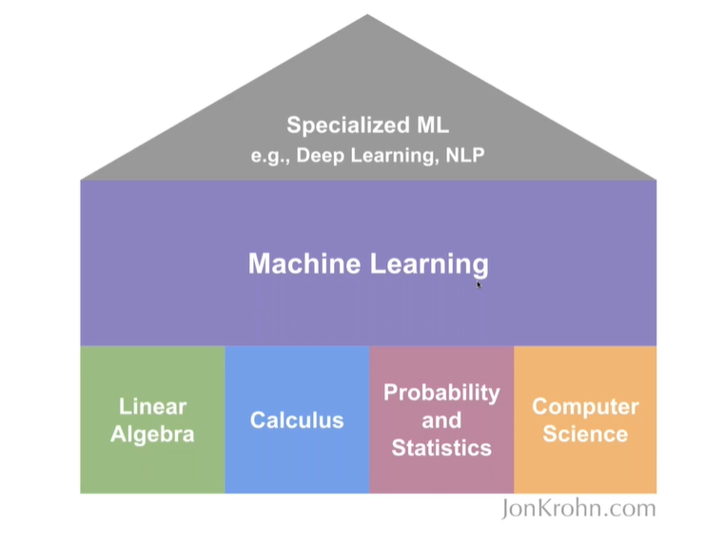

Slide 23
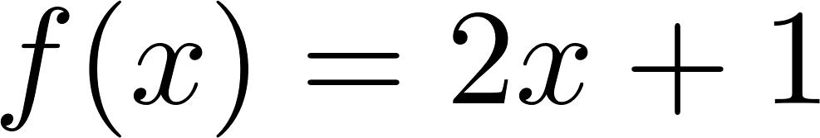
Background
Linear function

Slide 24
Background
Linear function
Once we know the name of function, we can tell how many parameters that we need to draw this.

Slide 25
Background
How can we model this?

Slide 26
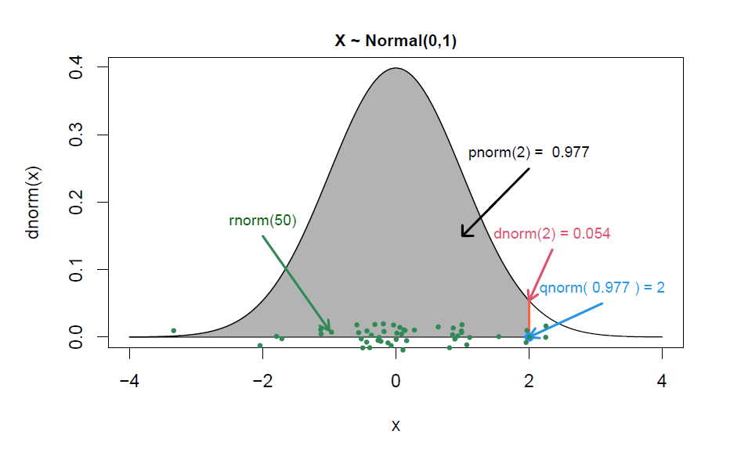
Background
How can we model this?

Slide 27
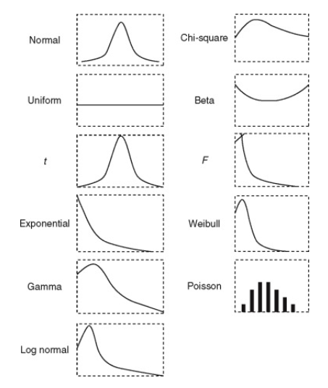
Background
Distributions
Need to know the name of the distribution
=> parameters
=> estimate the value of these parameters from sample we collect using estimator

Slide 28
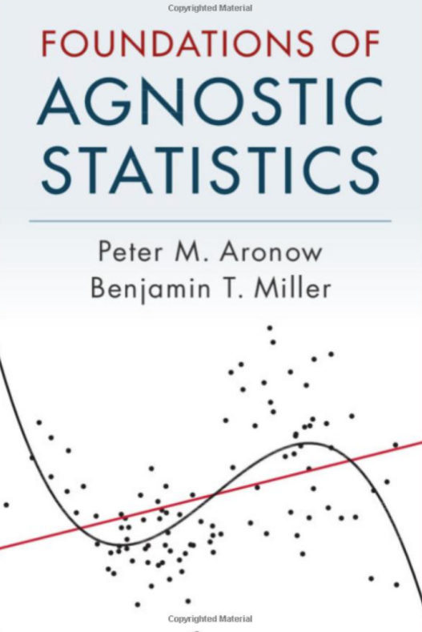
Background
Estimator
A statistic used to estimate the unknown population parameter
You want it to be efficient, unbaised and consistent
Statistic
- Function of sample

Slide 29
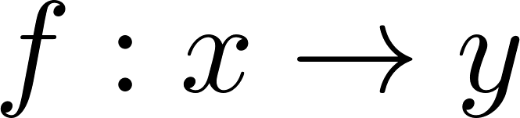

Background
Function, f, maps input x to y.
We will toss a coin, and when we get T, we will call it 1 and 0 if we get H.
X:{T,H}
{1,0}

Slide 30
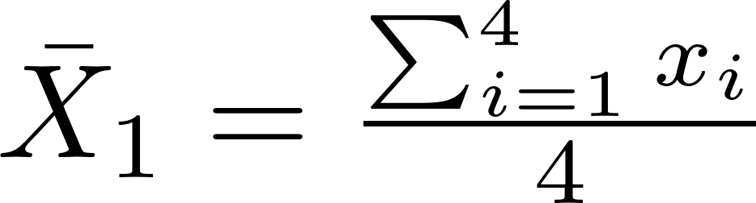
Background
We flip a coin 4 times and get the following result. We will let X to denote the result of this random experiment.
{T,T,T,T}

Slide 31
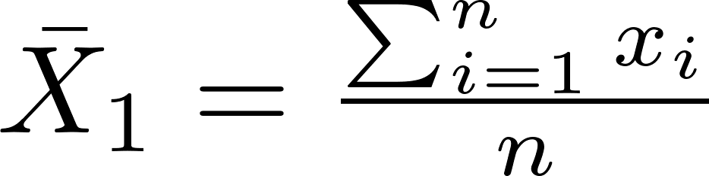
Background
We flip a coin n times and get the following result. We will let X to denote the result of this random experiment.

Slide 32
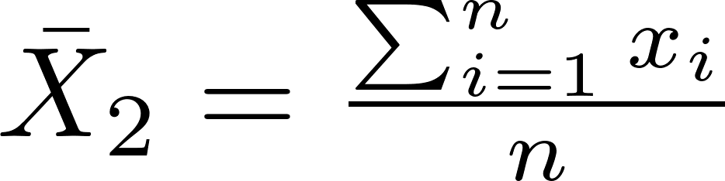
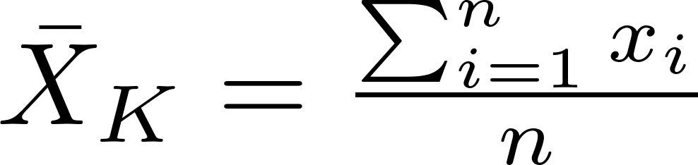
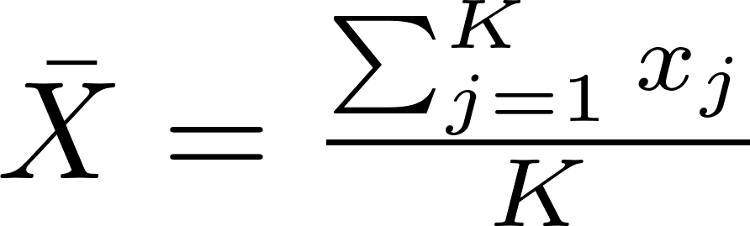
Background
Collect sample size n, K times.

Slide 33
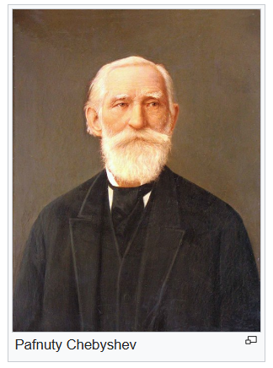
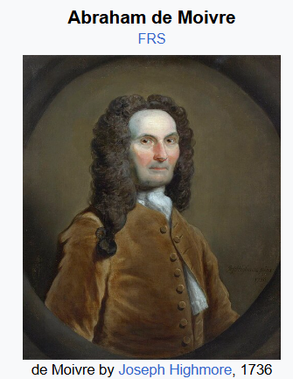
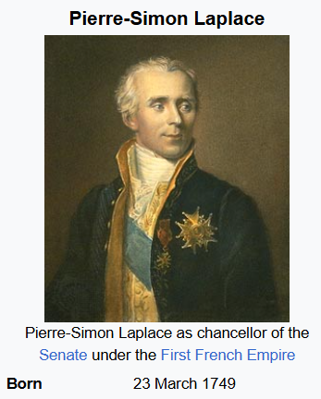
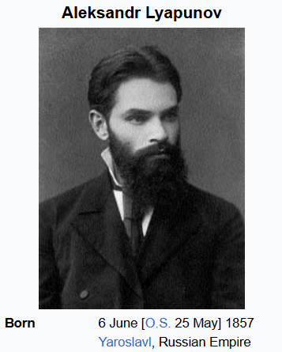
Background
Weak law of large numbers
Central limit theorem

Slide 34
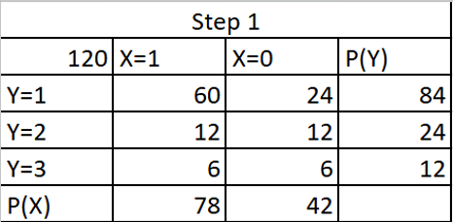
Background
We toss a coin and draw a ball from a box. Each ball in a box are labeled A, B and C
Contingency table

Slide 35
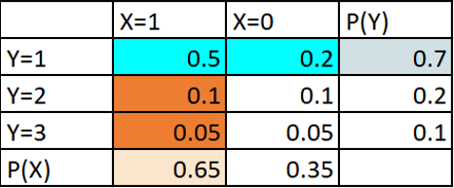

Background
We toss a coin and draw a ball from a box. Each ball in a box are labeled A, B and C
T
H
A
B
C
Contingency table
Joint PMF

Slide 36
Background
We toss a coin and draw a ball from a box. Each ball in a box are labeled A, B and C
T
H
A
B
C
Contingency table
Joint PMF
Marginal pmf of Y
Marginal pmf of X

Slide 37
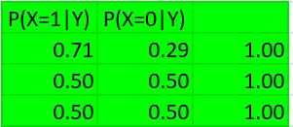
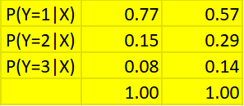
Background
We toss a coin and draw a ball from a box. Each ball in a box are labeled A, B and C
T
H
A
B
C
Contingency table
Joint PMF

Slide 38
Background
We toss a coin and draw a ball from a box. Each ball in a box are labeled A, B and C
T
H
A
B
C
Contingency table
Joint PMF

Slide 39


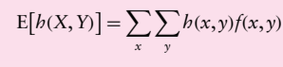
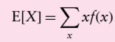
Background

Slide 40
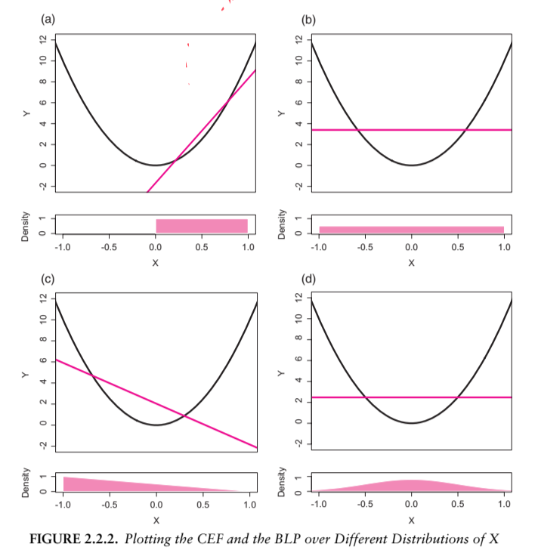
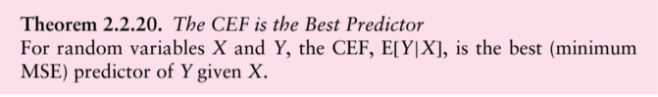
Background
BLP and CEF

Slide 41
Background
Cauchy, Eigenvalue analysis
Bayes’ theorem
1763
1773
1788
1829
1845
1906
De Moivre, coin toss, CLT
Markov chains were introduced by Russian mathematician Andrey Markov
Lagrange multiplier
Chebyshev inequality is used to prove the weak law of large numbers

Slide 42
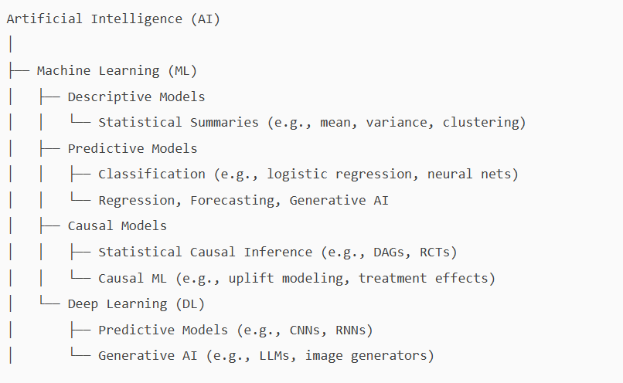

Slide 44

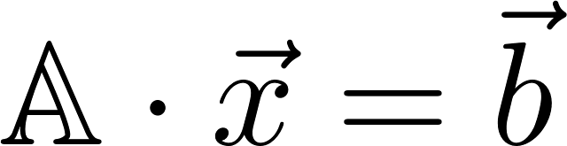
Background
Function, f, maps input x to y.
We will toss a coin, and when we get T, we will call it 1 and 0 if we get H.
X:{T,H}
{1,0}
Mapping a vector of size 5 to vector of size 3

Slide 45
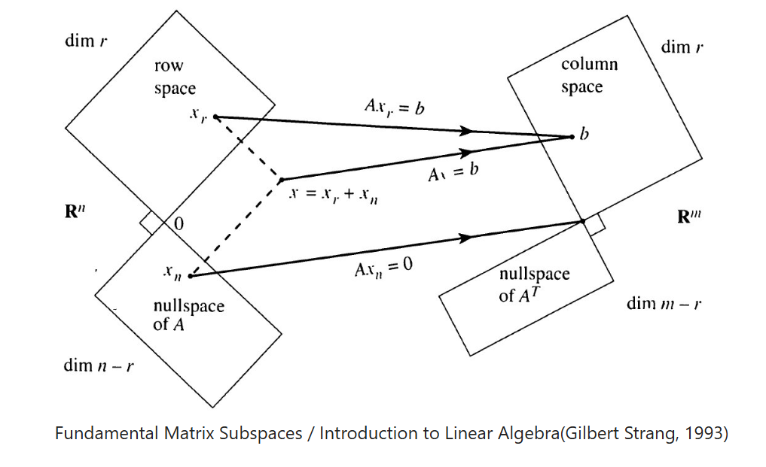

Slide 46
Domain and Codomain, basis, subspace, hyperplane
vector, norm, orthogonal, orthogonal complement subspace,
projection, error, residual, span, decomposition, rank of matrix
linear combination, null space, row space, column space, left null space,
changes of basis, principal component, singular value decomposition,
matrix, gram Schmit process, gram matrix, singular and nonsingular matrix,
eigen value, eigen vector and eigen decomposition, orthonormalization,

Slide 47
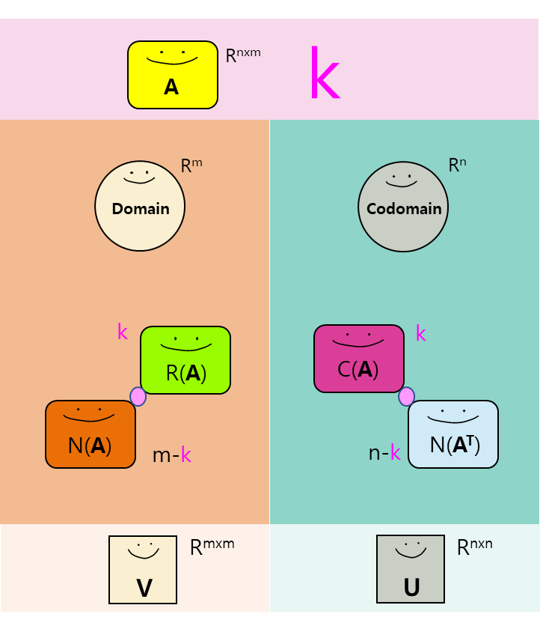

Slide 48
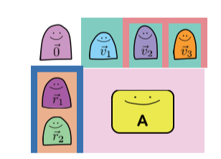

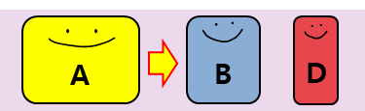


Chapter 1~3: FUNDAMENTAL FOUR SUBSPACES

Slide 49
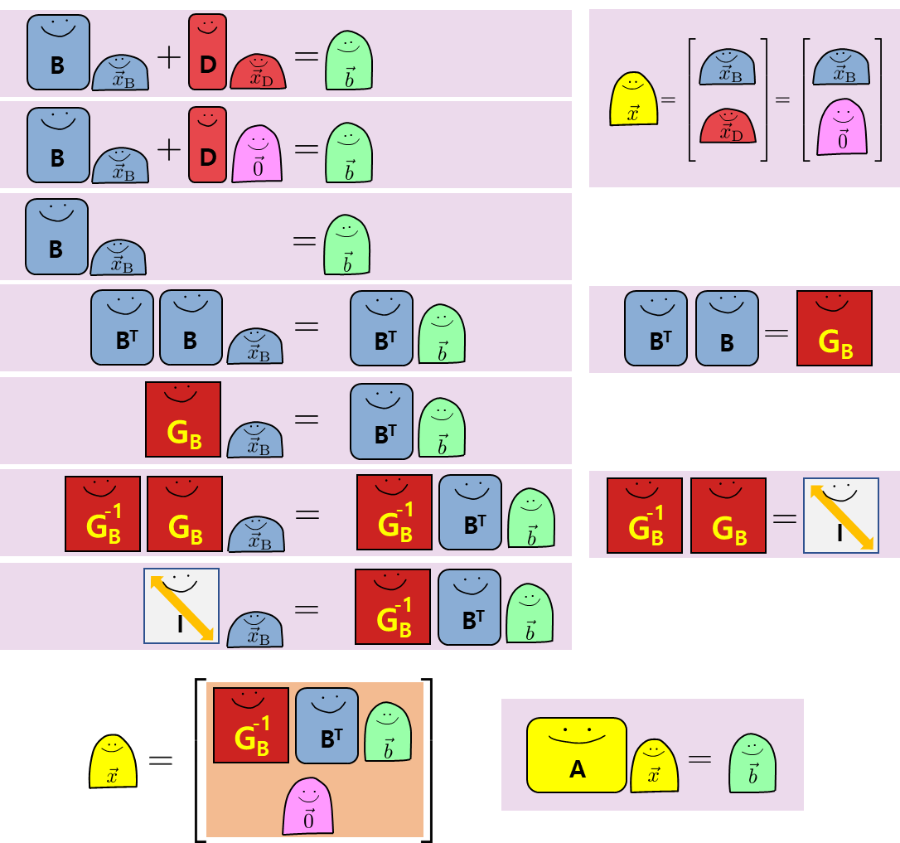
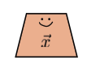


Chapter 4: Solving SYSTEMS OF EQuATIONS

Slide 50
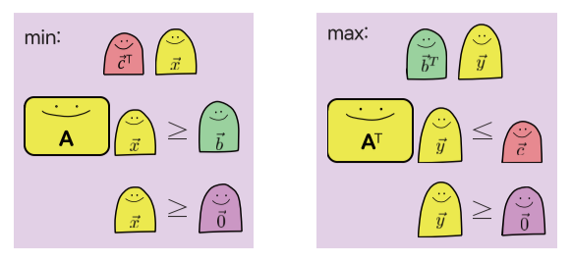
Chapter 4: LINEAR PROGRAMMING

Slide 51


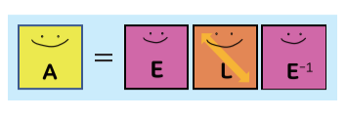



Chapter 5:
Eigen EVERYTHING and MARKOV CHAIN

Slide 52


Chapter 6: SVD and PCA

Slide 53


Denoising
Source: https://mbernste.github.io/posts/rna_seq_basics/

Slide 54

Avocado experiment

Slide 55




Avocado experiment
Treatment 1
Treatment 2
Treatment 3
Control

Slide 56

Avocado experiment

Slide 57

Avocado experiment

Slide 58

Avocado experiment

Slide 59


Avocado experiment

Slide 60

Avocado experiment

Slide 61
What humans find easy, AI find it hard.
What humans find it hard, AI find it easy.
It provides most likely answer.
Guessing what is the most natural thing to say next

Slide 62


Slide 63


Thank you
Q & A

